Slide 1

Monthly Income MLR Analysis DDS Project 2
Krithika Kondakindi

Slide 2
Problem
Building a model that best predicts Monthly Income based on the most accurate Variables. We will then use the model to predict Monthly Income for 300 additional working individuals.

Slide 3
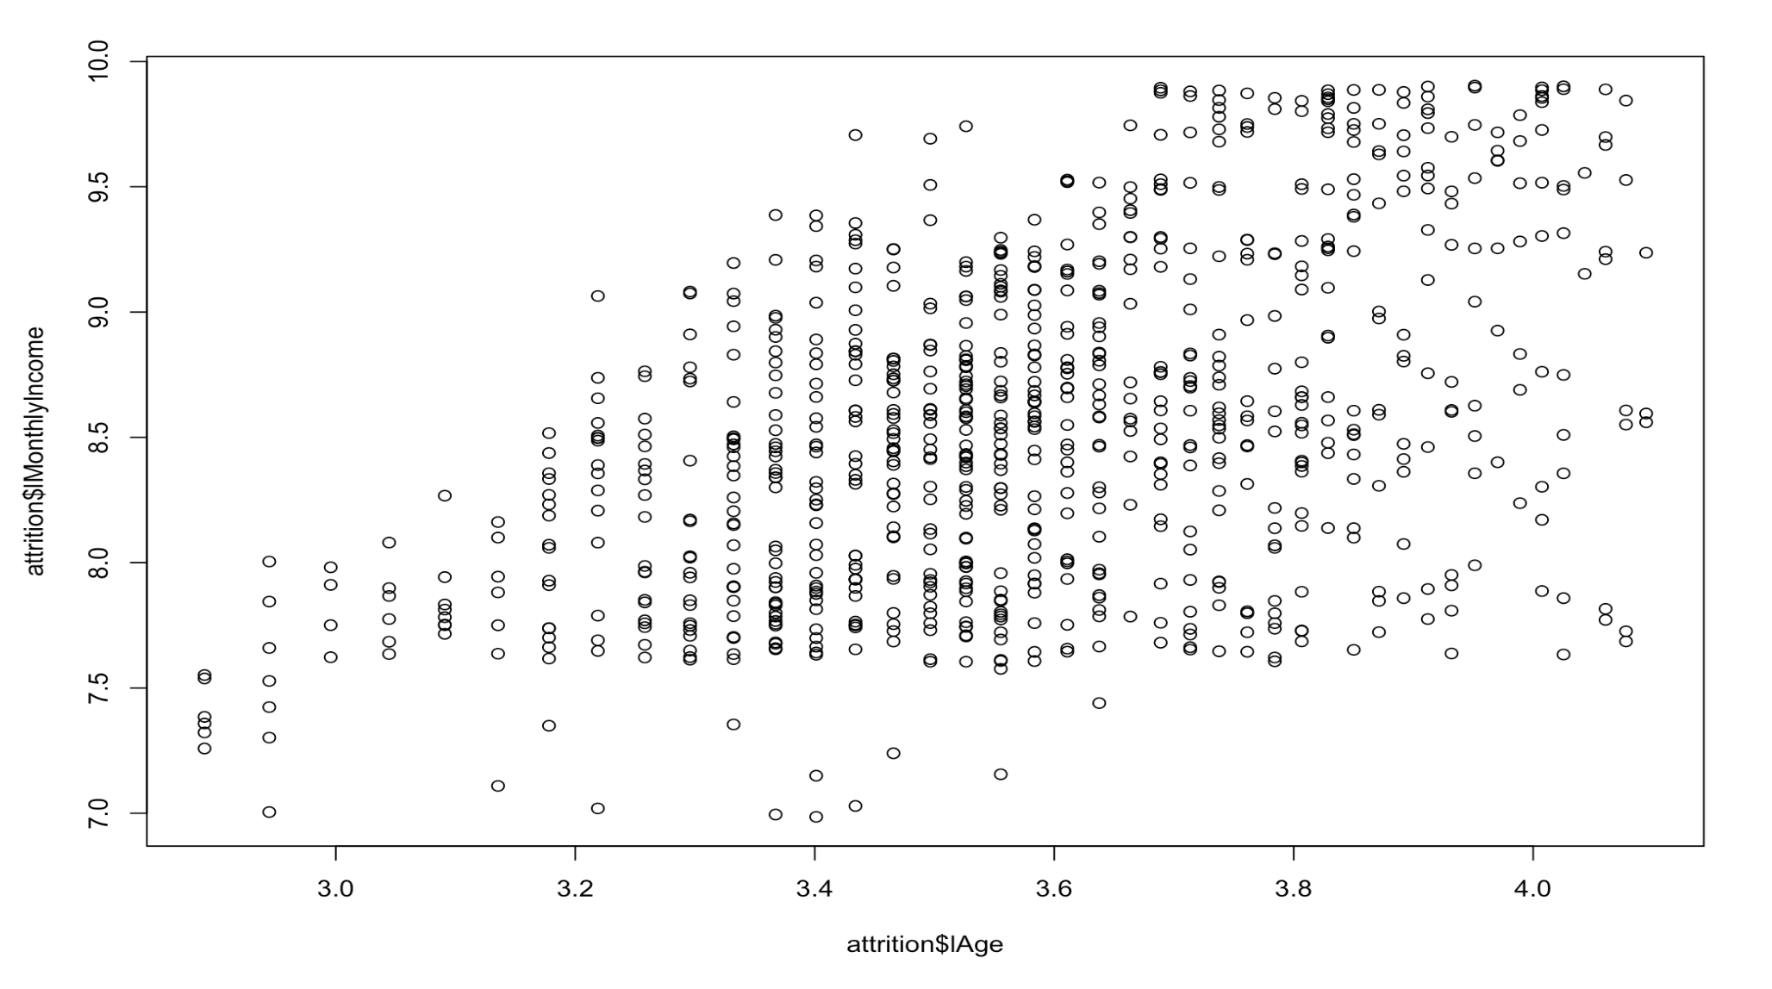
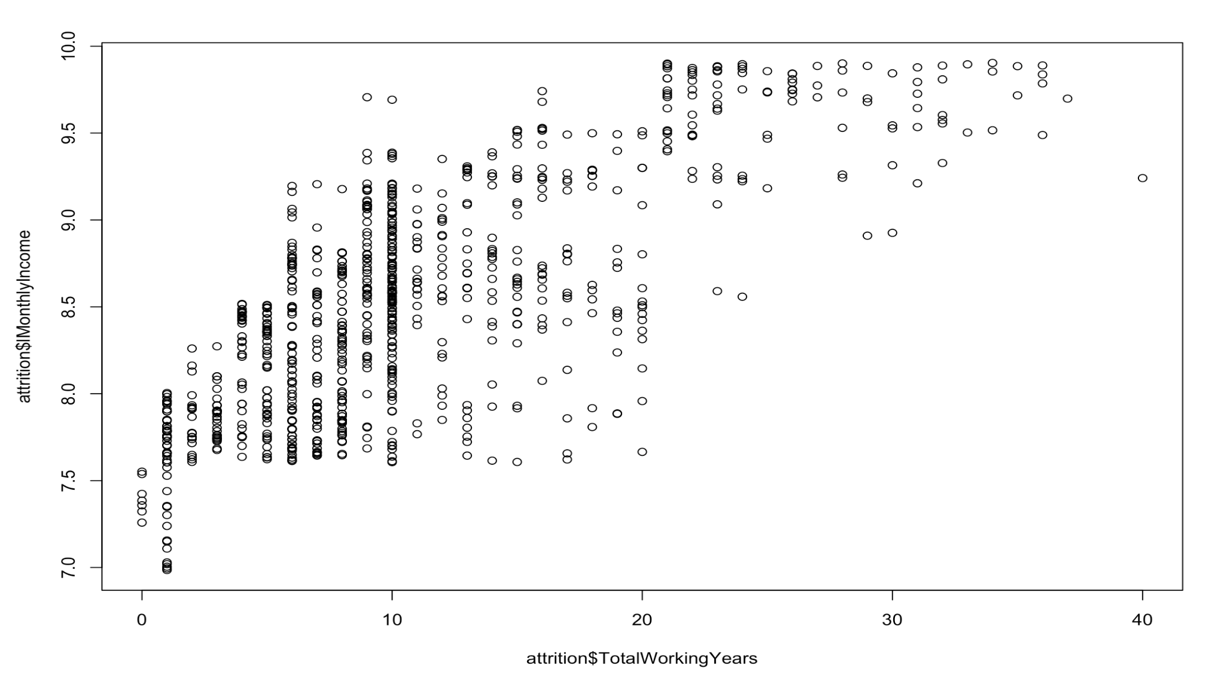
Variables
The variables chosen for this model are Age & Total Working Years
Scatterplots were run to see if there is evidence of linearity with Monthly Income variable

Slide 4
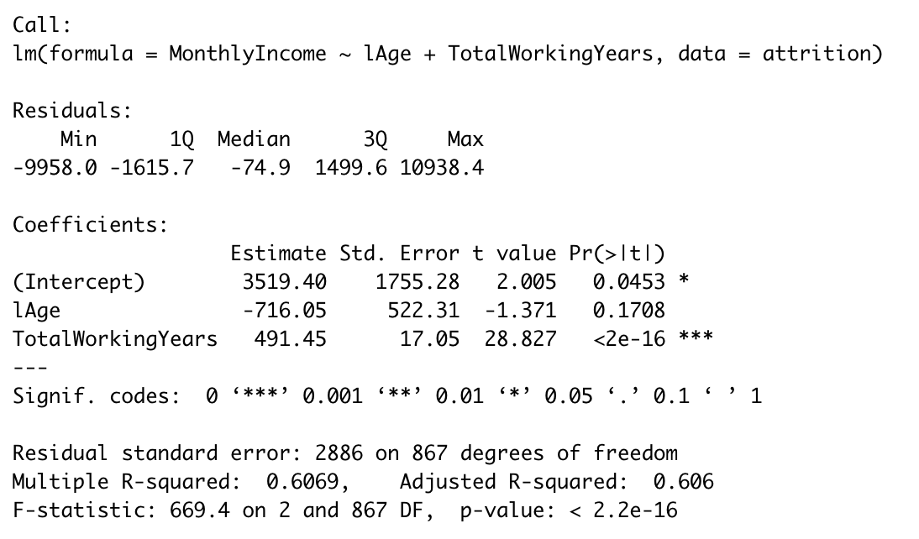
Model
Predicted log(Monthly Income) = 3519.40 + 491.45 (TotalWorkingYears)
*Note: While the slope for log(Age) is not statistically significant, we will not include it in the model to predict the Monthly Income for the 300 employees

Slide 5
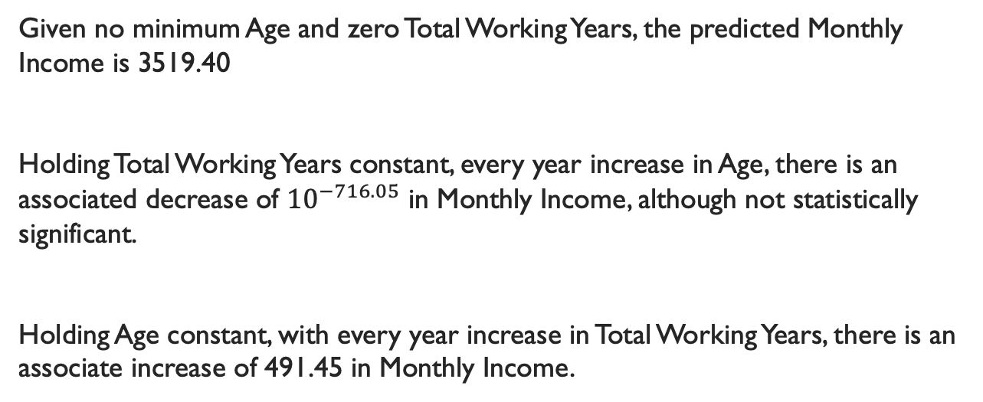
Interpretation
Given no minimum Age and zero Total Working Years, the predicted Monthly Income is 3519.40
Holding Total Working Years constant, every year increase in Age, there is an associated decrease of ${10}^{−716.05}$ in Monthly Income, although not statistically significant.
Holding Age constant, with every year increase in Total Working Years, there is an associate increase of 491.45 in Monthly Income.

Slide 6
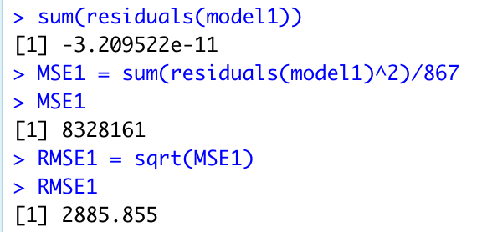
RMSE
The Root Mean Square Error (RMSE) measures the difference between the values predicted using an MLR model and the actual observed values. The lower the RMSE, the better the model fits the data.
The RMSE for this model is the following: 2885.855

